Slide 1
Gamify- A Game downloading website
Kannappan
Muhammed ali masood

Slide 2
introduction
Gaming is one of the sectors that is undergoing a huge growth in terms of usage and popularity. Games can be played by all people despite their age and gender. There are many games that are available online. Some games could be purchased using money and some of them could be downloaded for free. There needs to be a platform through which users can download games. We are planning to build frontend of one such platform using frontend tools like html, css, javascript and bootstrap.
The website would consist of a total of 5 pages namely, Home Page, Browse Page, Game news page, Sign up - login page and Support page. Home page of the website will also be the website landing page.

Slide 3
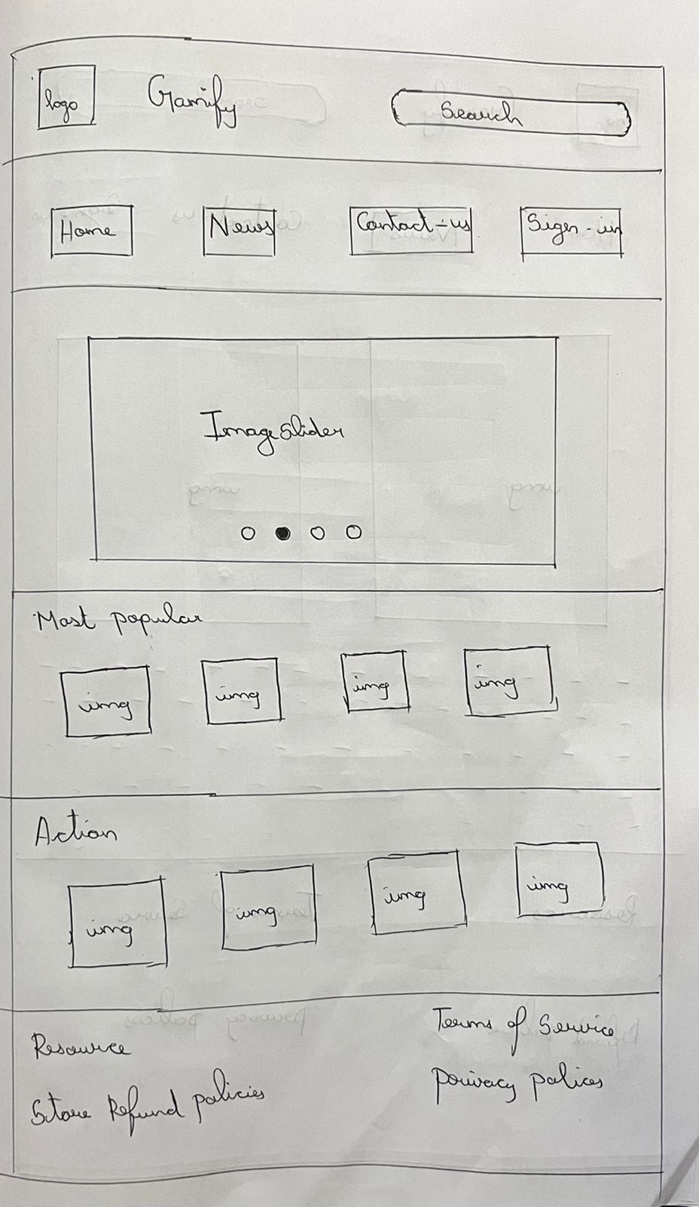
HOME PAGE

Slide 4
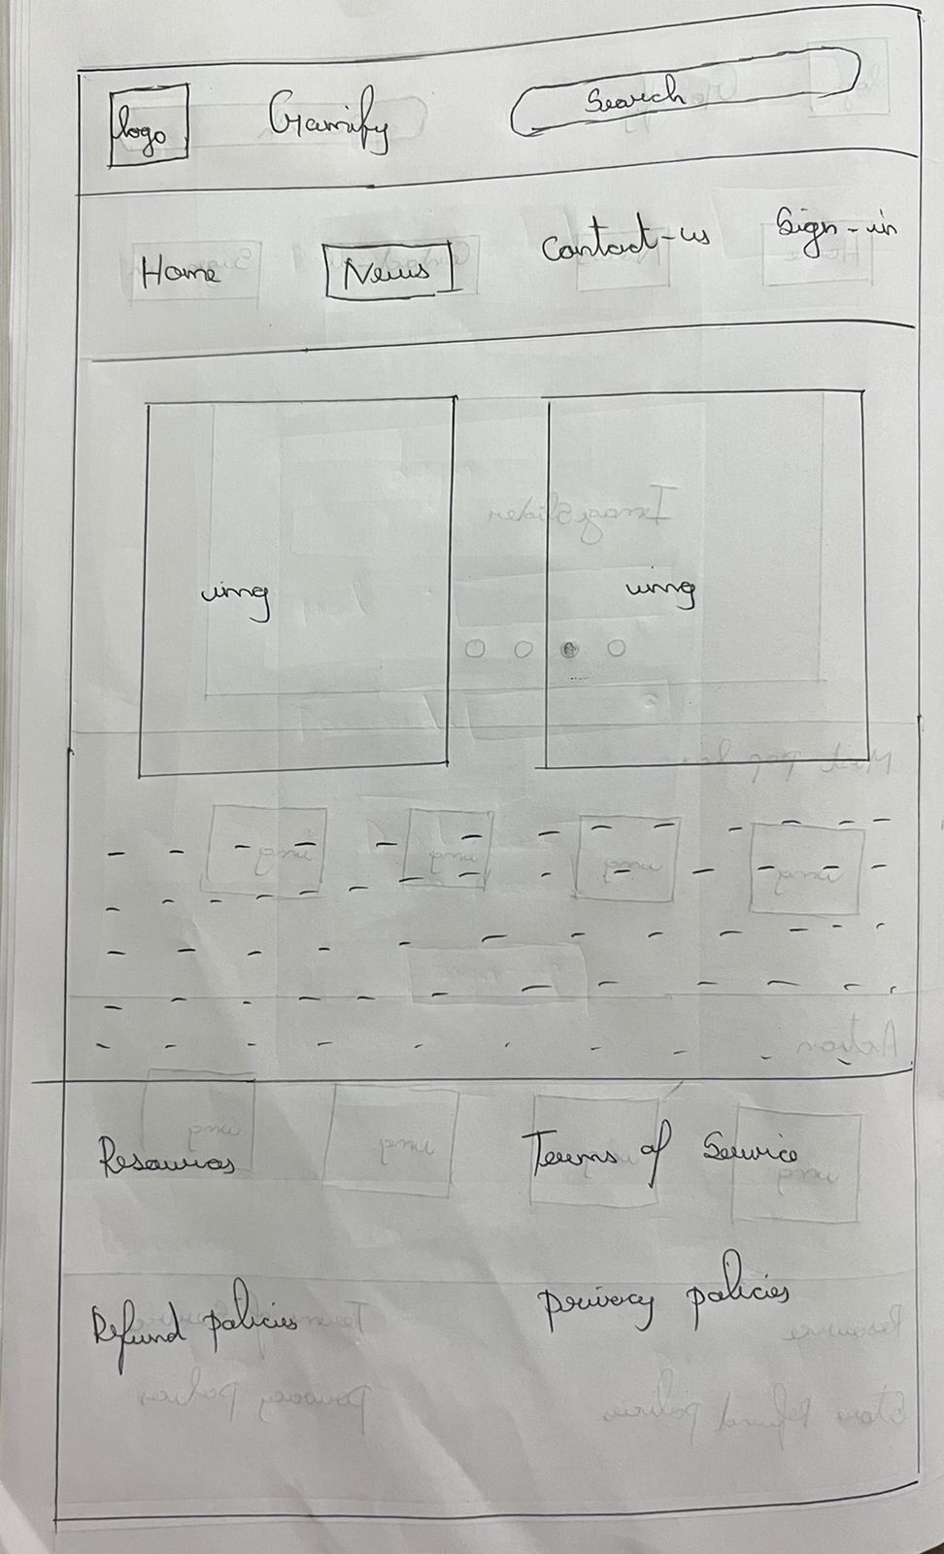
NEWS PAGE

Slide 5
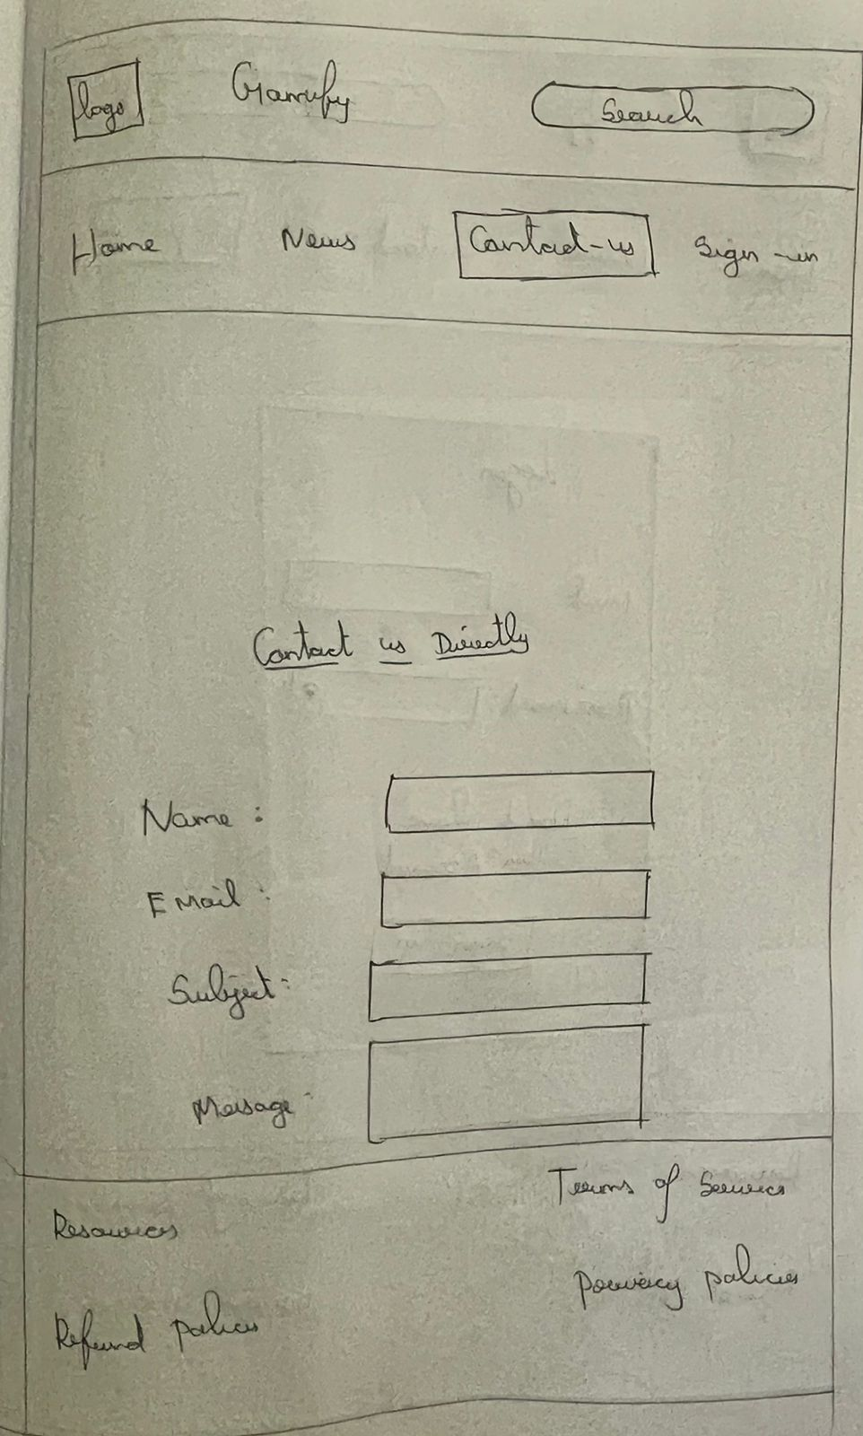
CONTACT US PAGE
FB
IG

Slide 6
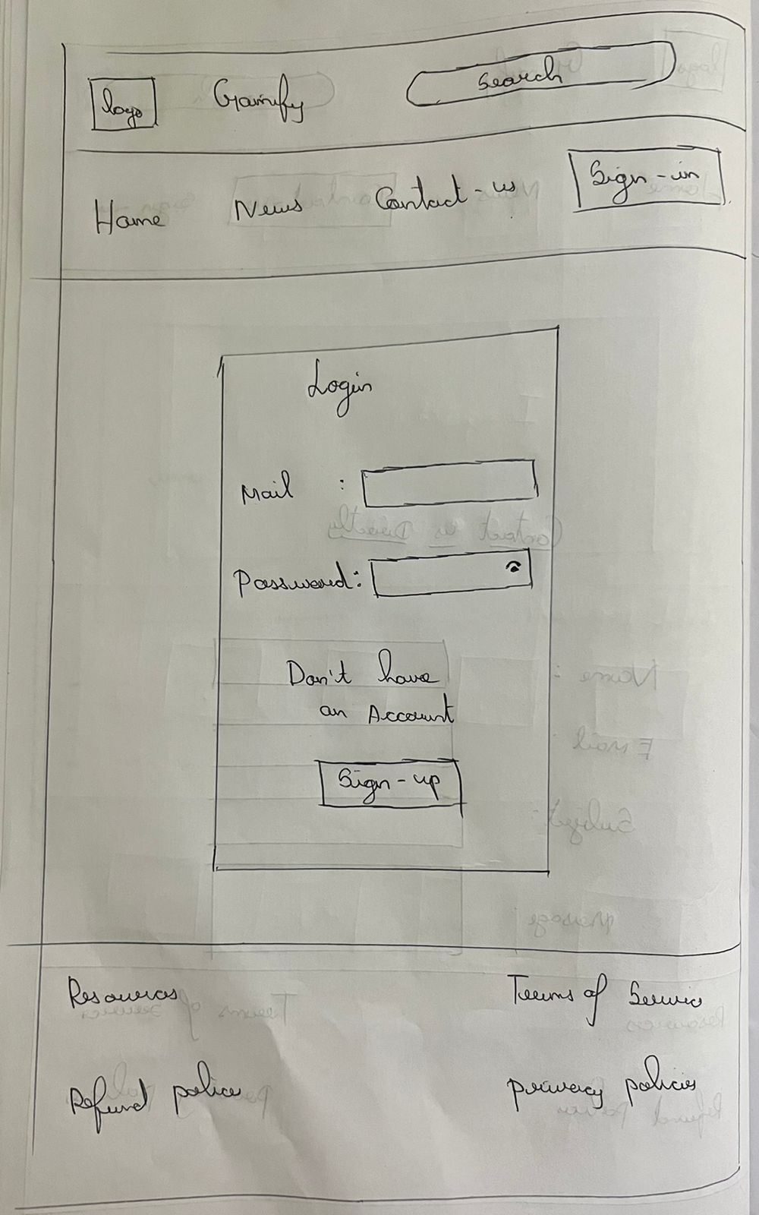
LOGIN PAGE

Slide 7
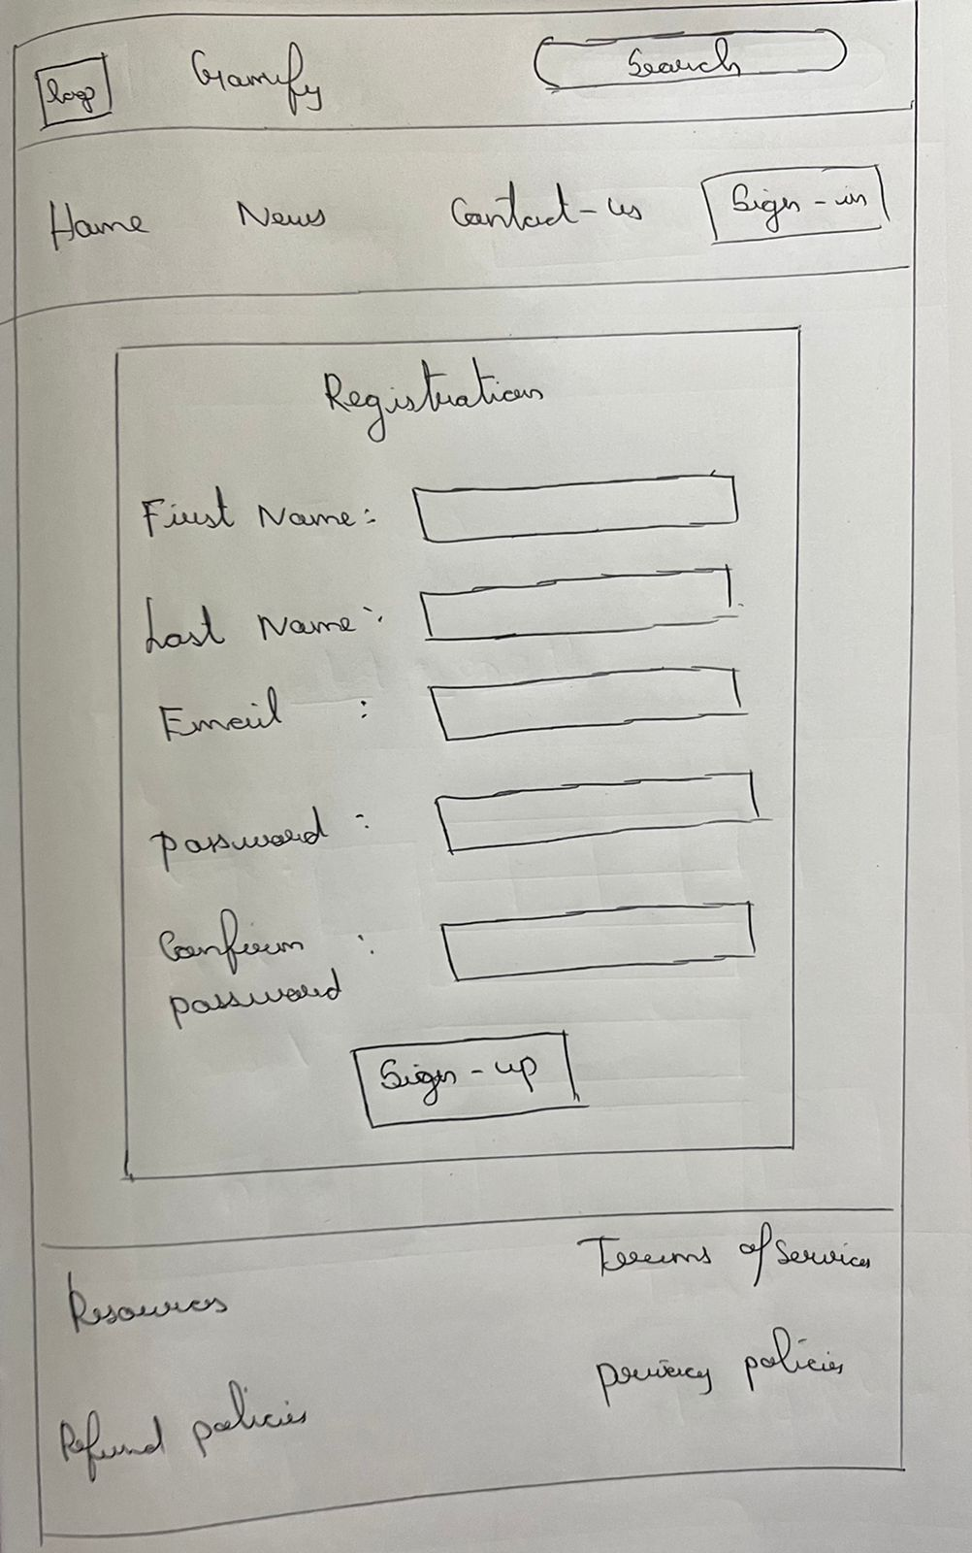
REGISTRATION PAGE

